Slide 1
UNIT-III
Four Pillars of IOT Paradigm
RFID
Wireless Sensor Networks (generic architecture)
SCADA
M2M

Slide 2
Radio Frequency Identification (RFID)
Radio Frequency Identification – or RFID – is used to automatically identify an object and capturing data about that object that has been stored in a small microchip tag and attached to the object.
RFID is a wireless system comprised of two components: 1.Tags
2.Readers.

Slide 3
The components of RFID
Using radio waves and electromagnetic fields to send data, an RFID tag and the system that reads it consists of three main components.
RFID tag
RFID reader
RFID applications or software

Slide 4
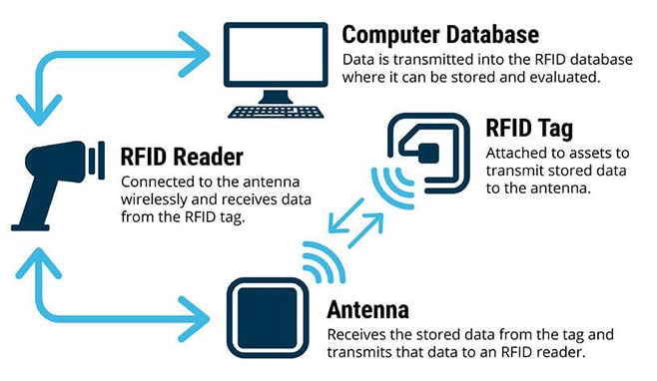

Slide 5
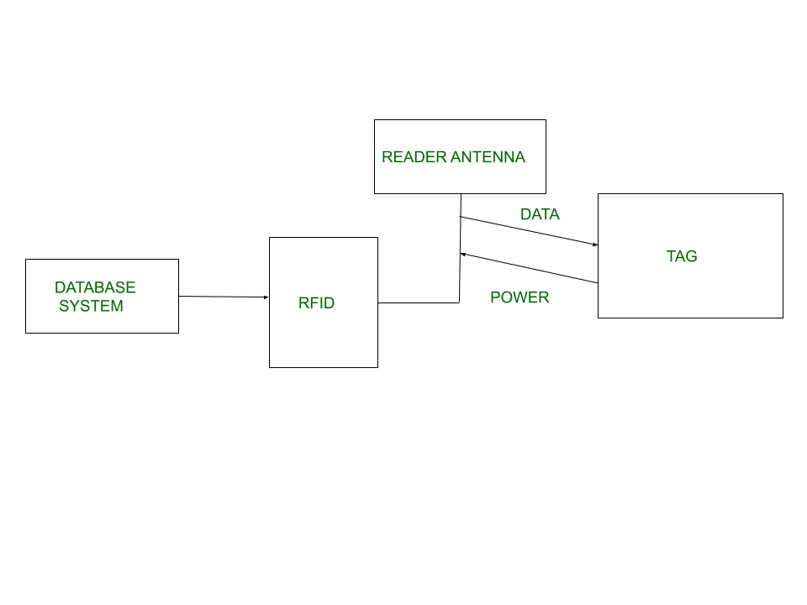

Slide 6
1)RFID tag:
There are two types of RFID tags, passive and active.
A passive RFID tag is the barcode you see in the supermarket. It is assigned to an item, it is easy to activate, and it does not have a power supply.
An active RFID tag, like the sensor tag in the back of a library book, has a microchip that collects information about the asset and may also contain an antenna or on-board sensor.

Slide 7
2)RFID reader:
An RFID reader is a device that scans the RFID tag and collects information about the asset the tag is attached to.
These readers can be hand-held or wired, and work with USB and Bluetooth.
Not all barcode scanners can read an RFID tag, but all RFID readers can read a barcode.

Slide 8
3)RFID applications or software:
This software controls and monitors the RFID tags that have been attached to your assets.
It can be a mobile application or a standard software package. Most of the time you can find RFID software that has a mobile application that works in conjunction with it. This software can communicate with the reader using Bluetooth or Beacon technology.

Slide 9
Features of RFID:
An RFID tag consists of two-part which is a microcircuit and an antenna.
This tag is covered by protective material which acts as a shield against the outer environment effect.
This tag may active or passive in which we mainly and widely used passive RFID.
Each RFID tag has its own unique identifying number.

Slide 10
Application of RFID:
It utilized in tracking shipping containers, trucks and railroad, cars.
It uses in Asset tracking.
It utilized in credit-card shaped for access application.
It uses in Personnel tracking.
Controlling access to restricted areas.
It uses ID badging.

Slide 11
Advantages of RFID:
It provides data access and real-time information without taking too much time.
RFID tags follow the instruction and store a large amount of information.
It improves the Efficiency, traceability of production.
In RFID hundreds of tags read in a short time.

Slide 12
Disadvantages of RFID:
There is privacy concern about RFID devices anybody can access information about anything.
Active RFID can costlier due to battery.

Slide 13
SCADA--Supervisory Control and Data Acquisition
SCADA stands for “Supervisory Control and Data Acquisition”.
SCADA is a type of process control system architecture that uses computers, networked data communications graphical Human Machine Interfaces (HMIs) to enable a high-level process supervisory management and control.
SCADA systems communicate with other devices such as programmable logic controllers (PLCs) and PID controllers to interact with industrial process plant and equipment.
SCADA systems form a large part of control systems engineering.

Slide 14
Wireless Sensor Network (WSN)
Wireless Sensor Network (WSN) is an infrastructure-less wireless network that is deployed in a large number of wireless sensors in an ad-hoc manner that is used to monitor the system, physical or environmental conditions.
1.Sensor nodes are used in WSN with the onboard processor that manages and monitors the environment in a particular area. They are connected to the Base Station which acts as a processing unit in the WSN System.
2.Base Station in a WSN System is connected through the Internet to share data.

Slide 15
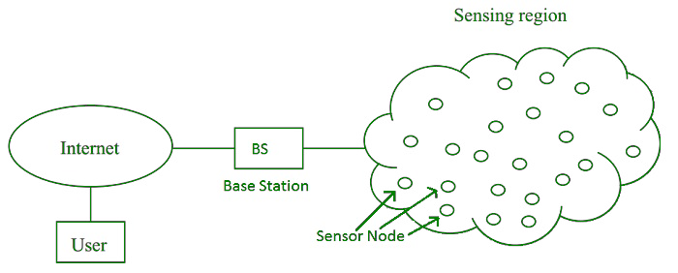

Slide 16
Applications of WSN:
Internet of Things (IOT)
Surveillance and Monitoring for security, threat detection
Environmental temperature, humidity, and air pressure
Noise Level of the surrounding
Medical applications like patient monitoring
Agriculture
Landslide Detection

Slide 17
Types of Communications in IOT
1.Human to Machine (H2M)
2.Machine to Machine (M2M)
3.Machine to Human (M2H)
4. Human To Human (H2H)

Slide 18
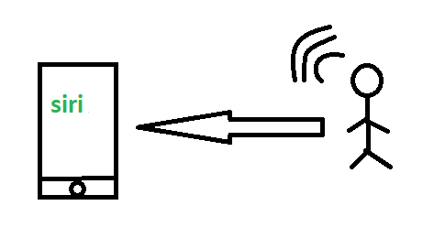
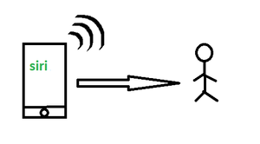
1.Human to Machine (H2M)
Examples:
Facial recognition.
Bio-metric Attendance system.
Speech or voice recognition.
2.Machine to Human (M2H)
Examples:
Fire Alarms
Traffic Light
Fitness bands
Health monitoring devices

Slide 19
3.M2M (Machine to Machine):
Machine-to-Machine (M2M) refers to networking of machines (or devices) for the purpose of remote monitoring and control and data exchange.)
Architecture for M2M systems comprising of
M2M area networks,
Communication network and
Application domain.
which have embedded hardware modules for sensing, actuation and communication.
Various communication protocols can be used for M2M local area networks such as ZigBee, Bluetooth, Modbus, M-Bus, Wireless M-Bus, Power Line Communication (PLC), etc.

Slide 20
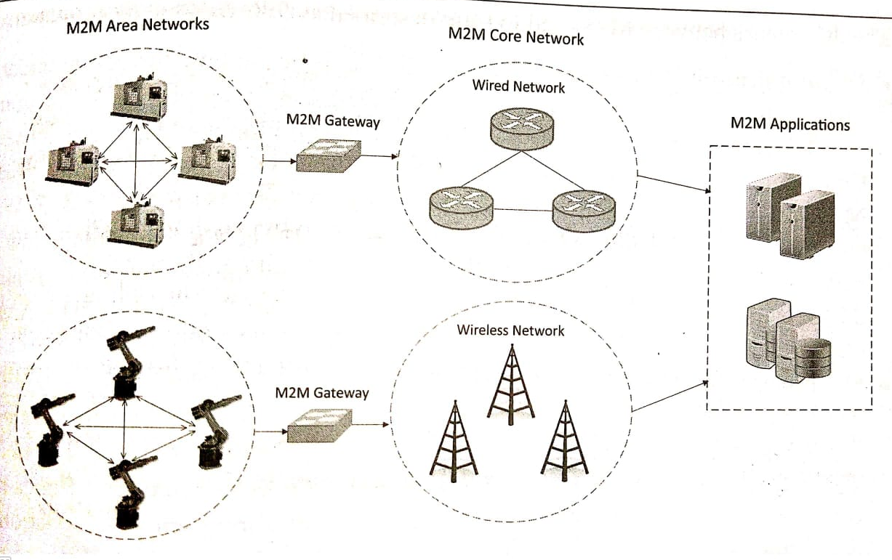
M2M system Architecture

Slide 21
These communication protocols provide connectivity between M2M nodes within an M2M area network.
To enable the communication between remote M2M area networks, M2M gateways are used.
M2M has various application domains such as smart metering, home automation, industrial automation, smart grids, etc.

Slide 22
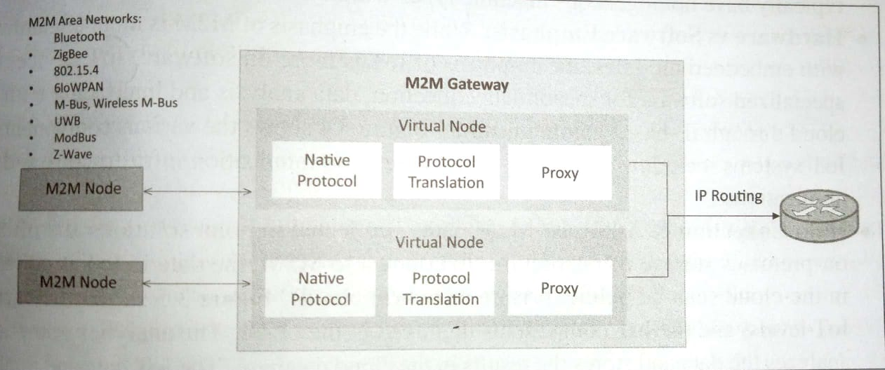
M2M Gateway

Slide 23
The communication between the M2M nodes and the M2M gateway is based on the communication protocols which are native to the M2M area network.
M2M gateway performs protocol translations to enable IP-connectivity for M2M area networks. M2M gateway acts as a proxy performing translations from/to native protocols to/from Internet Protocol (IP).
With an M2M gateway, each node in an M2M area network appears as a virtualized node for external M2M area networks.

Slide 24
Differences between M2M and IoT
Communication Protocols
Machines in M2M vs Things in IoT
Hardware vs Software Emphasis
Data Collection & Analysis
Applications

Slide 25
Communication Protocols
M2M
IoT
M2M uses either proprietary or non-IP based communication protocols for communication within the M2M area networks.
Commonly uses M2M protocols include ZigBee, Bluetooth, Modbus, M-Bus, Wireless M-Bus, Power Line Communication (PLC), etc..
The focus of communication in M2M is usually on the protocols below the network layer such as HTTP, COAP, WebSocket
IP based communication protocol
The focus of communication in loT is usually on the protocols above the network layer such as HTTP, COAP, WebSocket

Slide 26
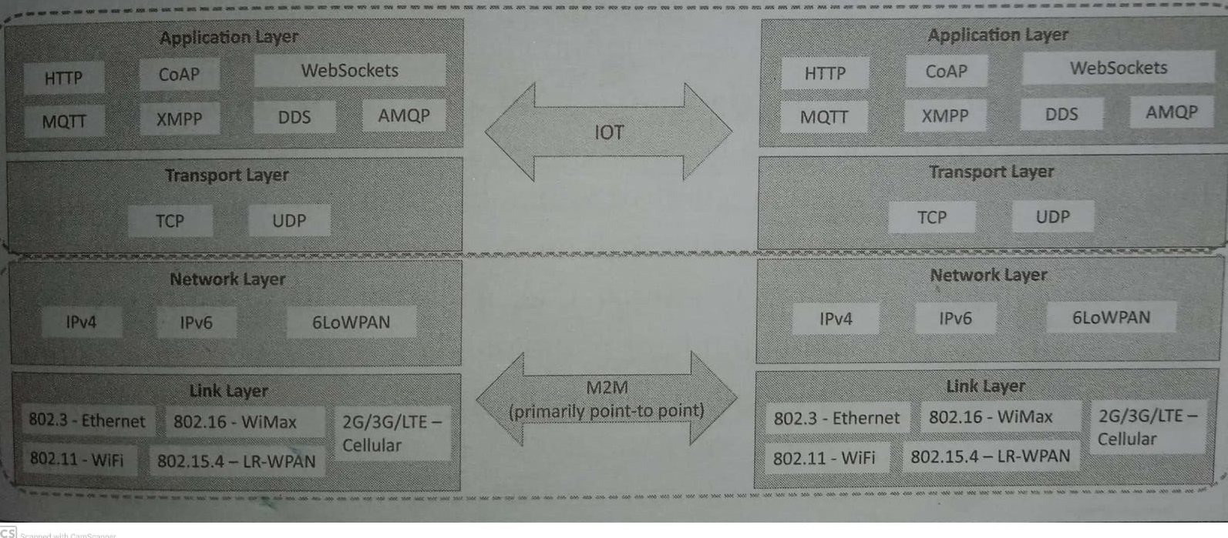

Slide 27
2.Machines in M2M vs Things in IoT
M2M
IoT
The "Things" in loT refers to physical objects that have unique identifiers and can Sense and communicate with their external environment (and user applications) or their internal physical states.
Homogeneous machine types within an M2M area network
. The unique identifiers for the things in loT are the IP addresses.
software components for accessing, processing, and storing sensor information, or controlling actuators connected.
IOT Systems can nave Heterogeneous things (e.g., a home automation IoT system can include lol devices of various types, such as fire alarms, door alarms, lighting control devices.

Slide 28
3.Hardware vs Software Emphasis
IoT
M2M
While the emphasis of M2M is more on hardware with embedded modules.
Emphasis of loT is more on software.
(loT devices run specialized software for sensor data collection, data analysis and interfacing with the cloud through IP-based communication)
Things
Internet
Applications

Slide 29
4.Data Collection & Analysis
M2M
IoT
In loT is collected in the cloud (can be public, private )
The analytics component analyzes the data and stores the results in the cloud database.
M2M data is collected in point solutions and often in on-premises storage infrastructure.
LEVEL-1
Application /Data base
IoT Levels and IoT cloud component

Slide 30
IoT Enabling Technologies
IoT is enabled by several technologies including
Cloud Computing,
Big Data Analytics,
Embedded Systems.

Slide 31
1) Cloud Computing:
Infrastructure-as-a-service (IaaS): provides users the ability to provision computing and storage resources. These resources are provided to the users as a virtual machine instances and virtual storage.
Platform-as-a-Service (PaaS): provides users the ability to develop and deploy application in cloud using the development tools, APIs, software libraries and services provided by the cloud service provider.
Software-as-a-Service (SaaS): provides the user a complete software application or the user interface to the application itself.

Slide 32
2) Big Data Analytics: Some examples of big data generated by IoT are
Sensor data generated by IoT systems.
Machine sensor data collected from sensors established in industrial and energy systems.
Health and fitness data generated IoT devices.
Data generated by IoT systems for location and tracking vehicles.

Slide 33
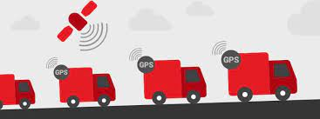
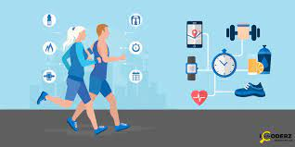

Slide 34
3)Embedded Systems: is a computer system that has computer hardware and software embedded to perform specific tasks. Embedded System range from low-cost miniaturized devices such as digital watches to devices such as digital cameras, POS terminals, vending machines, appliances etc.,

